Slide 1
Network Model
Welcome, students!

Slide 2
Network Model
To simplify networks, everything is separated in layers and each layer handles specific tasks and is independent of all other layers. Network models are used to define a set of network layers and how they interact. The two most widely recognized network models include the TCP/IP Model and the OSI Network Model.

Slide 3
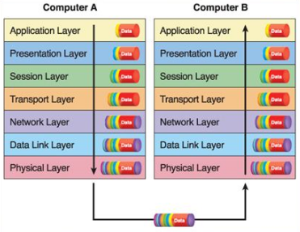
7 layers of OSI Model

Slide 4
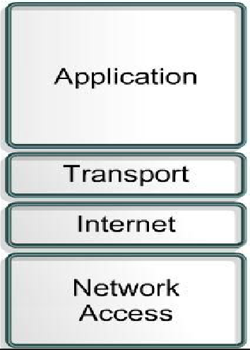
TCP/IP Model

Slide 5
Thank You ALL !!!

